Slide 1
RISK ANALYSIS ON TRUCK FLEET DATA
MIS 6346
BIG DATA
Group 1
Siddesh Chaudhari | Vansh Pathria | Pranav Bhanukumar | Leela Navaneeth Kakumanu

Slide 2

Business Objectives
RISK ANALYSIS
Identifying dangerous commercial truck drivers nationwide
RECOMMENDATIONS/ DECISION MAKING
To help the truck fleet Managers, to highlight the drivers who fall in the Risk-Factors
OFFER PERSONALISED SOLUTIONS BASED ON ANALYSIS
We will be using multiple Risk factors to determine each driver’s risk factor.

Slide 3
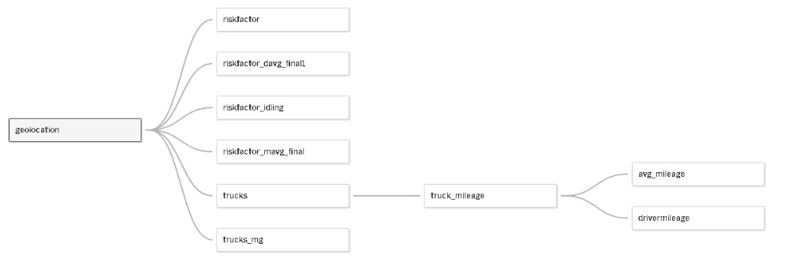
Information about the data
The datasets used for this project has been retrieved from census.gov and other public internet resources.
Important Columns used from the tables that we considered for analysis in the datasets are Driver ID /Truck Id, Event, Risk Factor, State, city, Truck model, Velocity

Slide 4






Process flow
CSV
DATA RECEIVED IN .CSV
VM
LOADED DATA IN VM USING ‘DRAG N DROP’
HADOOP
LOADED THE DATA IN HADOOP USING ‘PUT’ COMMAND
HIVE/IMPALA
CREATED TABLES USING HIVE
PIG
ADDED 2 RISKFACTORS USING ‘PIG’
TABLEAU
USED FOR VISUALIZATION AND GETTING INSIGHTS

Slide 5
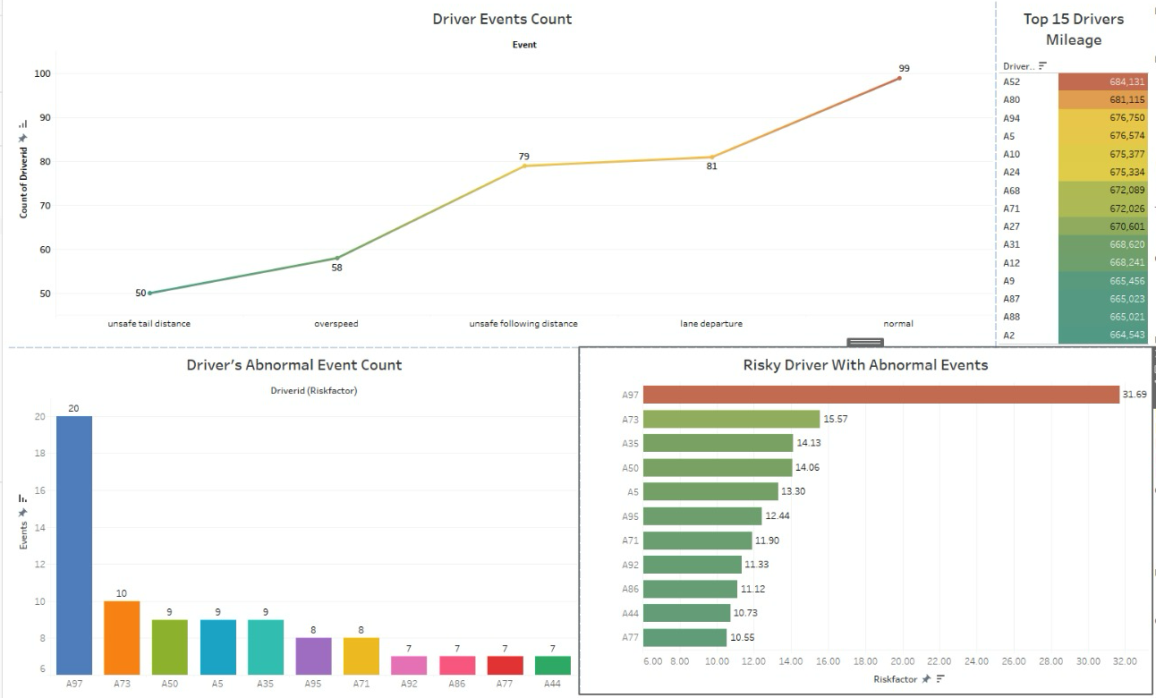
Model based on Abnormal Risk Factor

Slide 6
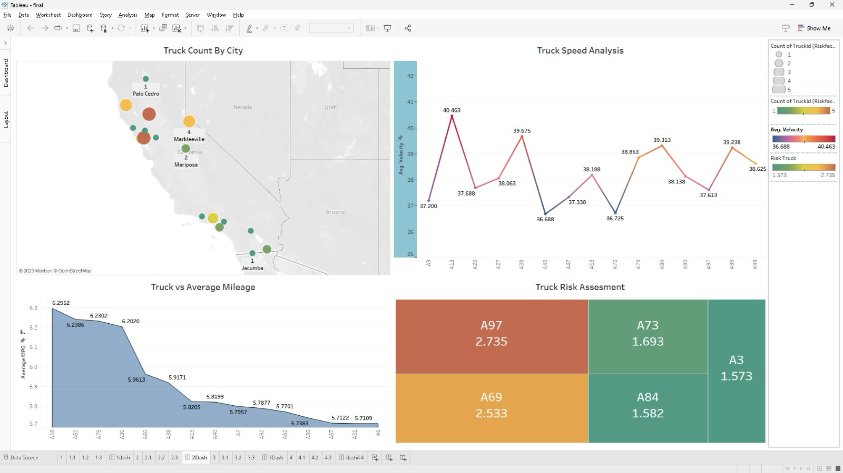
Model based on speed-mileage RISK Factor

Slide 7
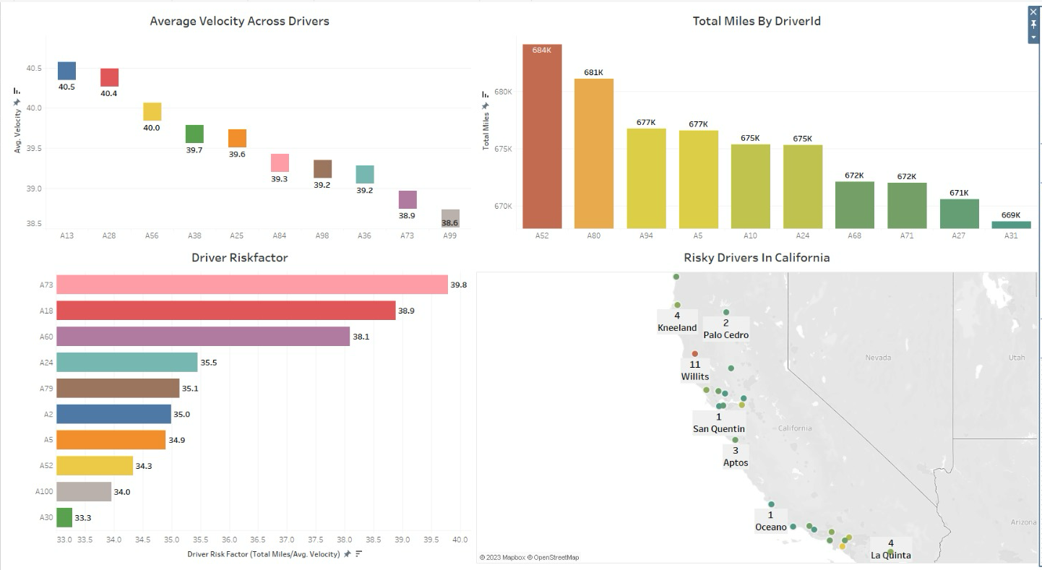
Model based on Driver Activity Velocity Factor

Slide 8
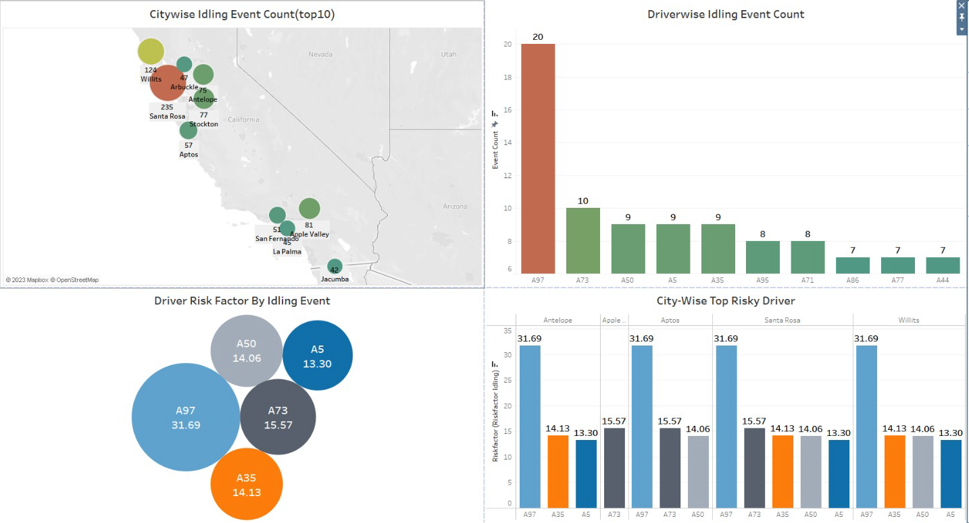
Model based on idling event Factor

Slide 9
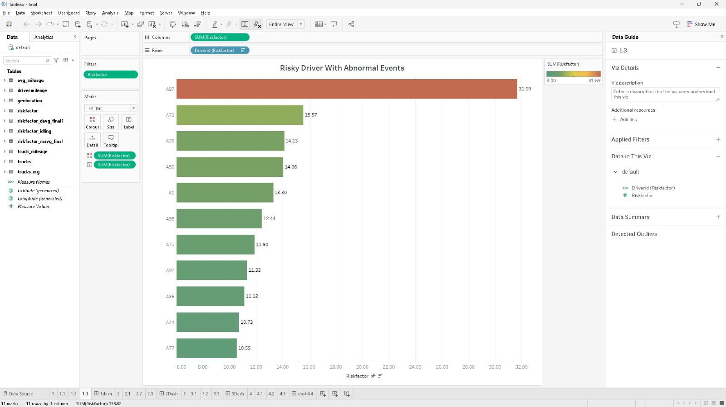
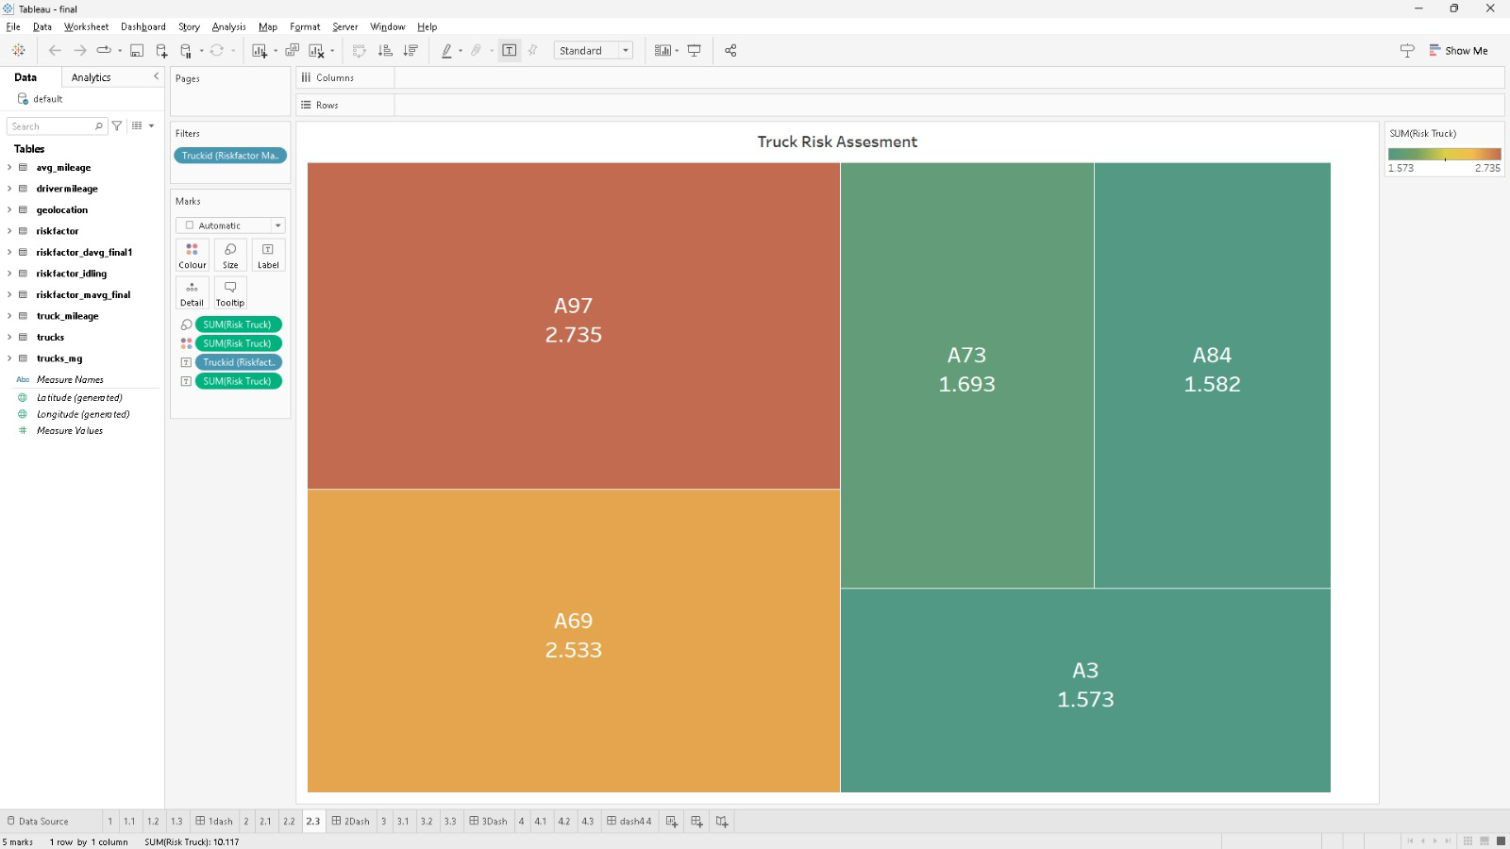
Risk-factor FOR Top 10 Risky Drivers With Abnormal Event
Risk-factor FOR
Top 5 Risky TRUCKs With speed-mileage

Slide 10
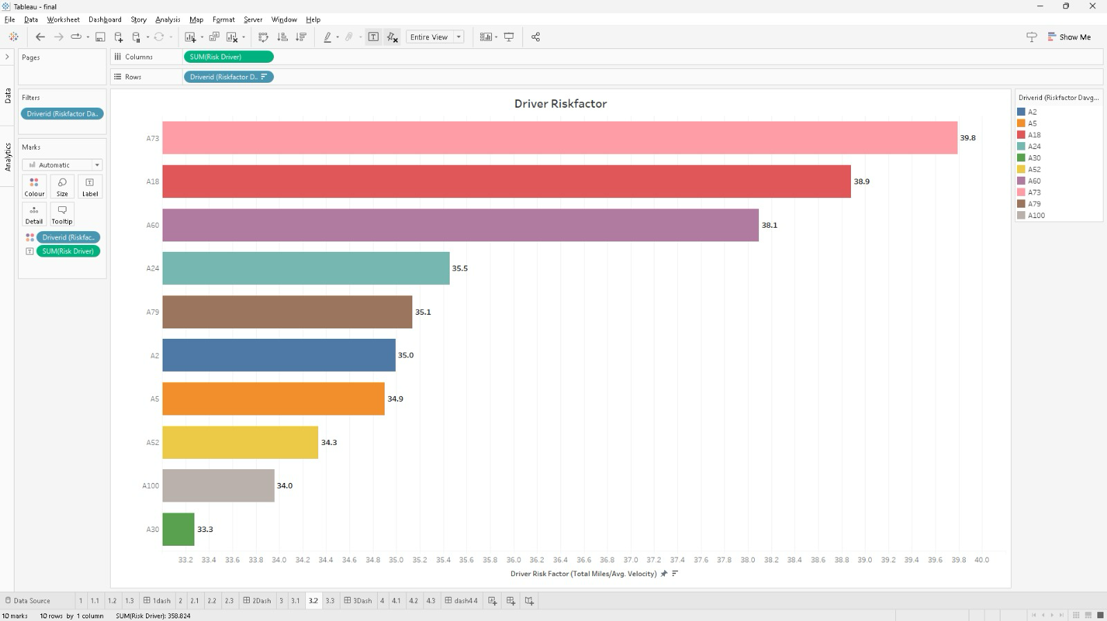
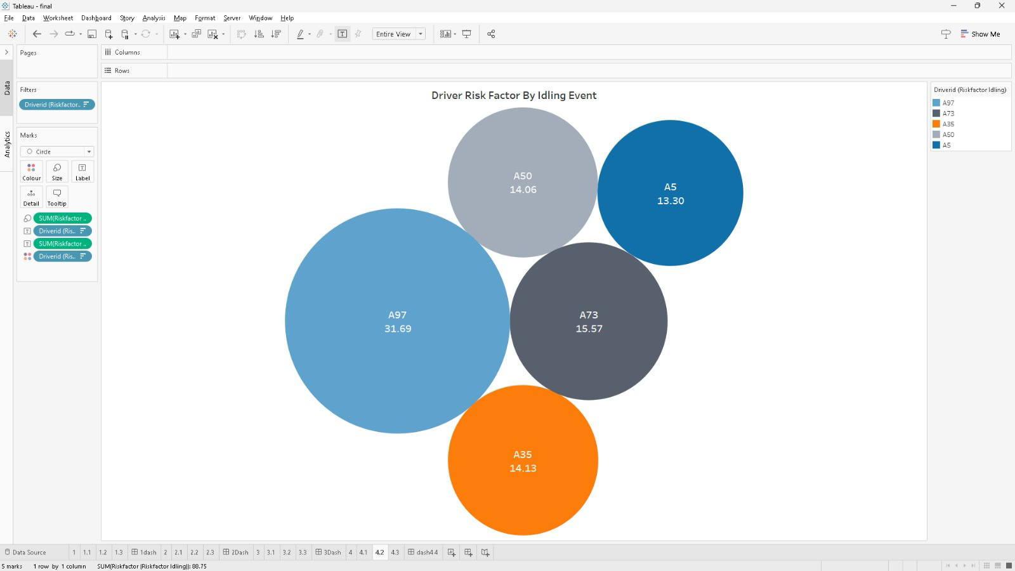
Risk-factor FOR Top 10 Risky Drivers With Driver Activity Velocity
Risk-factor FOR
Top 5 Risky Drivers With Idling Event

Slide 11
Challenges during the project
CONNECTING TO TABLEAU: We faced errors while connecting the database to tableau due to glitches in the database server.
POPULATING THE RISK FACTOR TABLE USING PIG SCRIPT: We faced challenges in running the Pig script designed to populate the risk factor database because we lacked experience in executing Pig scripts..
TIME MANAGEMENT: This endeavor brought forth new ideas. However, before putting them into action, we had to acquaint ourselves with these concepts. We successfully managed a substantial challenge related to time allocation.

Slide 12

Conclusion
Lane departure is the highest risk causing event, thus using features like lane assist will help significant mitigation of risk.
Based on our study Driver id with A97 is exceedingly risky in every risk factor category.
Driver id with A73 is most likely to cause accidents following A97.
Almost the same driver ids appeared frequently across the various risk factors considered, suggesting that these drivers are indeed associated with higher levels of risk.

